Slide 1
EABs: True Partnerships & Critical Friends
John Murphy & Nick Leader

Slide 2
Berwyn EAB: Who we are
Established: July 1st 2021
John Murphy Chair (CEO, Murphy Group)
Nick Leader Governor
Sarah Atherton MP Wrexham
Debbie Bryce West Cheshire & North Wales Chamber of Commerce
Dawn Moore Group People Director Murphy Group
Norah Keller Head of Reducing Re-Offending
Lucy Williams NFN North West
Helen Kneale Head of Education
James Sparrow Accelerator National Employment Lead
Michael McLoughlin Prisoner Representative*
Notes:
John leading?
Group had the right people, not too big to start off with as we needed to make things happen.
My only thought of gap would be getting local employment lead practically involved – a couple showed some motivation but have not stood up to the challenge.
Governor sponsorship and support was critical at getting prison buy-in
We have benefited fro Lucy Williams supporting us from NFN – without this our Wales coverage simply would not have provided this support – gave some consistency in approach with North West prisons.

Slide 3
Berwyn Employment Strategy
Culture of Employment
Preparing for Employment
Employment Hub & Employer Engagement
Through the Gate feedback
Nick Leader
Helen Kneale
Lucy Williams
Norah Keller
John Murphy
Dawn Moore
Debbie Bryce
Notes:
John Leading?
Developing a strategy to drive our changes was important – taking account of our needs:
Creating a momentum where resettlement priorities were highlighted and brought to life
Good to have a positive focus coming out of Covid
Named people gave a degree of ownership and accountability – also good have prison and board partnerships
The strategy is evolving and updates give it some ‘life’ – all four key elements have improved

Slide 4
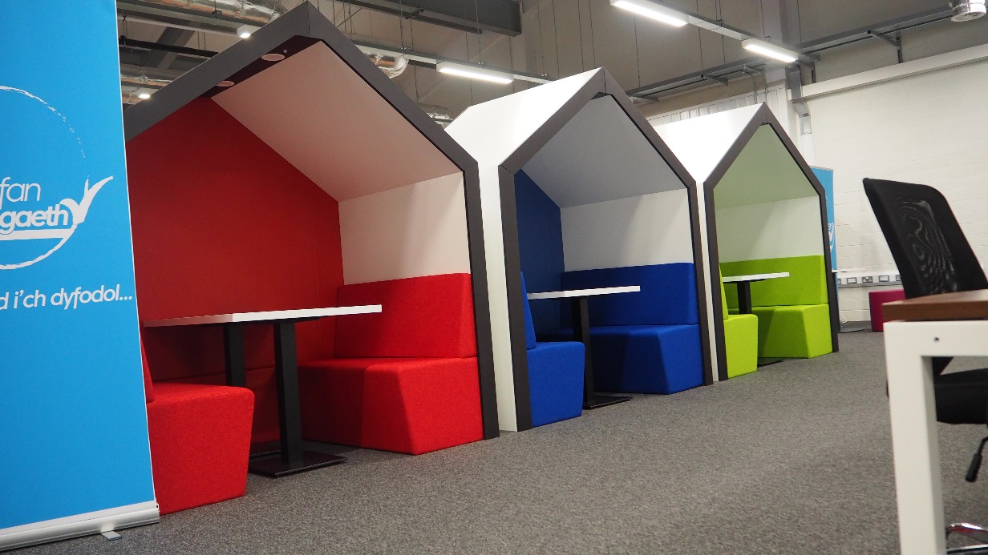
Creating the right environment
Our Resettlement Hub
Notes:
Nick leading?
Cost benefit – reduced some activity space but created an environment where various people were located – a bit of a one stop shop:
Probation and offender Management staff.
Agencies such as DWP
Resettlement staff.
Work base for Novus Cambria work Coaches
Accelerator leads were based including employment
Prisoner activity staff were based
Made a decision that employment work – and other resettlement work – needed a focus, a home where space was provided that:
Looked professional to prisoners, staff and outside agencies
Helped engagement with prisoners, agencies and employers (IT Connectivity one example of this)
Gave a space to create an environment that stimulated interest in employment
Difficult to assess but I think made one of the biggest differences t our work – some might already have such an engagement space – if not I would create one.

Slide 5
Performance Report April 2022
Employment at Six Weeks
2021 Performance: 7-10%
2021/22 Entry performance: 20%
Target: 30%
Release on Temporary Licence
2021 Performance: 0
2021/22 Entry performance: 10
Target: 20
Notes:
Nick Leading?
We cared about outcomes but had not prioritised as much as we have now
Accelerator focus helped.
Set a target of 30% and are on the way – month on month improvements because teams are working better together, prisoner pressure now also driving success.
Launching ROTL for a CAT C place was critical but proper work ROTL – National minimum wage, employment on release and competing employers looking to exploit this but also give prisoners real work experience – go to work from 6.00, working weekends and we make things happen to reflect the needs of the job. I want 20 working ROTL’s to be one of the critical bedrocks for engagement with employers

Slide 6
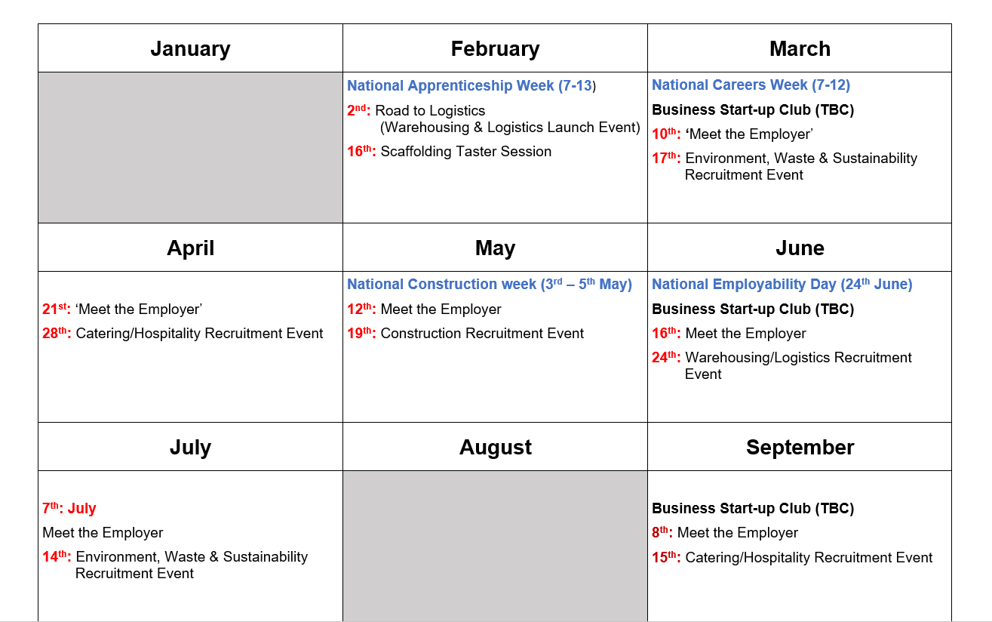
Calendar of Events
To support sectors and business who want to develop a recruitment pipeline.
Annual Calendar of Events
1st: Meet the Employer (Week1)
2nd: Recruitment Event (Week 2)
New Futures Network Events
Chamber of Commerce Events:
Business Start Up Club
Local Contacts
Academy-based Events
Employer led Interview and CV Support
Notes:
Nick Leading?
Calendar created in partnership with NFN – helps give accountability to the Board – also a focus for keeping the development of our work on track.
Schedule in advance to help planning - although need some flexibility to respond to employer needs.
We have work ready people at events who are in the resettlement window – they come prepared – great to see men turn up with 8 CBV’s and go up to employers, thank them for attending, hand over a CV and explain how they are looking forward to being interviewed for real jobs – great also seeing some competition between employers for the best prisoners!

Slide 7
Example: 2-week Construction Event
Week 1: Meet the Employer: Roles, Expectations, CV support
Week 2: Job interviews (REAL jobs)
Men with 3-12 months left to serve
Maximise use of excellent facilities at Berwyn
Basis Skills package (with NFN and CITB)
Men have CV and training pathway support
First employer engagement event, 4th May to broaden reach
Notes:
John leading – Nick adding context
Buzz from prisoners – couldn’t believe it was people wanting them.
Reality check and real job offers made a difference
Need to keep people ‘job warm prior to and on release’ – learnt and are now giving greater on TTG support via Novus Cambria work coaches
Event with CITB on 4 May

Slide 8
Working Relationship: Board, Chair & Governor
Chair View
Governor view
Governor and team are supportive and engaged:
Prisoner surveys, better comms
Willing to try new things:
Employer Events, Chamber of Commerce
Open to suggestions from diverse EAB.
External challenge and scrutiny
Personal coaching and new ways of working
Enabling us to open prison access to new employers

Slide 9
Next Steps: More than ‘An Initiative’
Build process around the improvements made
Seek out opportunities for continued improvement
Board feedback
Pinch with pride from other EABs and prisons
Addition of a prisoner representative.
Integration with other Accelerator and resettlement pathways
Explore prison/HMPPS employment opportunities

Slide 10
Questions!

